Slide 1
Agenda
Docker Fundamentals
Introduction to Docker
Docker Desktop
Docker For Developers
Docker for .NET Applications
Docker Community vs. Docker Enterprise
Docker Basics
Docker Hub
Container Life Cycle
Docker Engine
Docker Storage

Slide 2
Introduction to Docker
A light weight, open and secure platform for developing, shipping and running applications using container technology.
Provides Container solutions for developers, architects, DevOps, and IT People.
Run on most Linux distributions, Windows and Mac OS.
Supported by most of cloud providers like AWS, Azure, Google etc.
Provide Dev/Test, CI and DevOps platform for many use cases.
Notes:
Using Docker as a standalone software is good for development of applications, as developers can run their applications in isolated environments. What’s more, testers can also use Docker to run applications in sandbox environments. If you wish to use Docker to run a high number of containers in the production environment you may encounter some complications along the way. For example, some containers can easily be overloaded or fail. You can manually restart the container on the appropriate machine, but manual management can take a lot of your valuable time and energy.
Kubernetes allows you to resolve these issues by providing key features such as high availability, load balancing, container orchestration tools, etc. As a result, Kubernetes is most suitable for highly loaded production environments with a high number of Docker containers. Deploying Kubernetes is more difficult than installing a standalone Docker application, which is why Kubernetes may not always be used for development and testing.

Slide 3
Docker Benefits
Infrastructure Cost Savings
Standardization and Productivity
Isolation
Security
Makes app lifecycle efficient and consistent
Continuous Deployment and Testing
On Demand Scaling
Multi-Cloud Platforms Support

Slide 4
Docker Desktop
An application for Mac and Windows to build production-ready container applications
Enables to build and test Linux & Windows based applications at local machine
Available in two editions:
  Desktop Community
  Desktop Enterprise

Slide 5
Docker Desktop Installation
The Docker Desktop installation includes :
  Docker Engine
  Docker CLI client
  Docker Compose
  Docker Machine
  Dashboard
Containers and images created with Docker Desktop are shared between all user accounts on machines where it is installed.
Notes:
Kitematic provides an intuitive graphical user interface (GUI) for running Docker containers. Kitematic integrates with Docker Machine to provision a VirtualBox VM and install the Docker Engine locally on your machine.
Since all Windows accounts use the same VM to build and run containers

Slide 6
Docker For Developers
Applications
(.NET Core, Java, JS etc.)
Windows Server
Linux/Ubuntu Server

Slide 7
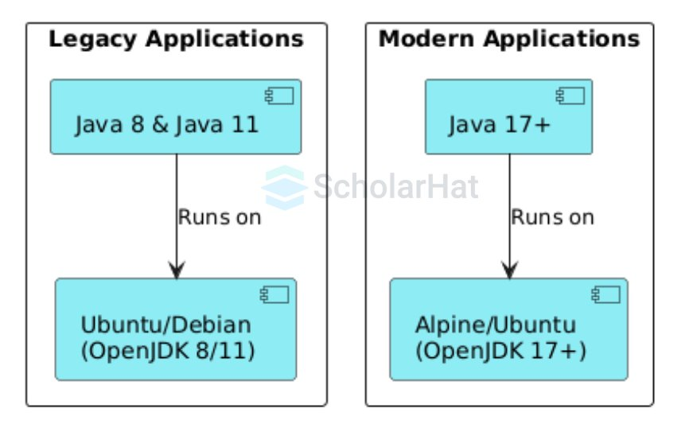
Docker For Java Applications

Slide 8
Docker Community vs. Docker Enterprise
Docker Community
For developers and small organizations
Free
Stable version (every 3 months)
edge version (every month), with cutting edge features
Docker’s CLI and API are used for create, build and deploy application
Docker Enterprise
For business and production apps
Subscription model
Stable version (every 3 months)
Additional enterprise features (management, security etc.)
Universal Control Plane is used for create, build and deploy application

Slide 9
Docker Basics
Docker File
Docker Image
Docker Container
Docker Registry

Slide 10
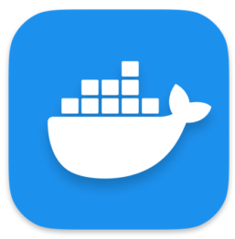
Docker File
A simple text file that contains commands to build a docker image.
This file doesn’t have any extension.
docker build
Dockerfile
Notes:
A Dockerfile is a recipe for creating Docker images
A Docker image gets built by running a Docker command (which uses that Dockerfile)
A Docker container is a running instance of a Docker image

Slide 11

Docker Image
A lightweight, standalone and executable package of software.
Includes everything which is needed to run an application like code, runtime, system tools, system libraries, and settings.
An image is a stack of multiple read-only layers referencing another image.
Created by docker build command.
Stored in Docker registry (eg. Docker Hub, Azure Container Registry etc.).
Image = Layered File System
Base Image (Ubuntu)
.NET Core SDK
…
Notes:
Docker images are a collection of files, which have everything needed to run the software application inside the container. However, they are ephemeral, meaning that any data that is written inside the container, while it is running, will not be retained.
If the container is stopped and restarted from its image, the container will run exactly the same as the first time, absent of any changes made during the last run cycle. Changes to the container either have to be made during the image creation process, using the Dockerfile that become part of the image, or data can be retained by mounting a persistent storage volume, from inside the container to the outside. This will be explored further in the HOL exercises below.

Slide 12
nginx Container
> docker pull nginx:1.25-alpine
> docker run --name nginx -p 8000:80 nginx:1.25-alpine
> docker run --name nginx -d -p 8000:80 nginx:1.25-alpine

Slide 13
Docker File Sample
FROM nginx:1.25-alpine
WORKDIR /usr/share/nginx/html
COPY ./dist/angularapp .
docker build -t ngapp:v1 .
docker run -d -p 8080:80 --name ngapp ngapp:v1

Slide 14
Docker File Sample
# Stage 1: Build
FROM maven:3.9.6-eclipse-temurin-21 AS build
WORKDIR /app
# Copy pom.xml and download dependencies
COPY ConsoleDockerApp/pom.xml ConsoleDockerApp/
RUN mvn -f ConsoleDockerApp/pom.xml dependency:go-offline
# Copy source code and build the app
COPY ConsoleDockerApp/ ConsoleDockerApp/
RUN mvn -f ConsoleDockerApp/pom.xml clean package -DskipTests
# Stage 2: Run
FROM eclipse-temurin:21-jre AS runtime
WORKDIR /app
# Copy compiled app from build stage
COPY --from=build /app/ConsoleDockerApp/target/ConsoleDockerApp-*.jar app.jar
# Run the app
ENTRYPOINT ["java", "-jar", "app.jar"]
docker build -t console-java:v1 -f ./ConsoleDockerApp/Dockerfile .
docker run --name consoleapp-java console-java:v1

Slide 15

Layer Sharing between Images
.NET Core App Image
Java App Image
…
…
.NET Core SDK
Java SDK
Base Image (Ubuntu)
No Redundancy
Notes:
Docker images are a collection of files, which have everything needed to run the software application inside the container. However, they are ephemeral, meaning that any data that is written inside the container, while it is running, will not be retained.
If the container is stopped and restarted from its image, the container will run exactly the same as the first time, absent of any changes made during the last run cycle. Changes to the container either have to be made during the image creation process, using the Dockerfile that become part of the image, or data can be retained by mounting a persistent storage volume, from inside the container to the outside. This will be explored further in the HOL exercises below.

Slide 16
Docker Container
Container is a running instance of a docker image
An isolated and secured shipping container
Run by docker run command
docker run
Operating System
Software: SDK/Runtime
Application Code
Notes:
Docker images are a collection of files, which have everything needed to run the software application inside the container. However, they are ephemeral, meaning that any data that is written inside the container, while it is running, will not be retained.
If the container is stopped and restarted from its image, the container will run exactly the same as the first time, absent of any changes made during the last run cycle. Changes to the container either have to be made during the image creation process, using the Dockerfile that become part of the image, or data can be retained by mounting a persistent storage volume, from inside the container to the outside. This will be explored further in the HOL exercises below.

Slide 17
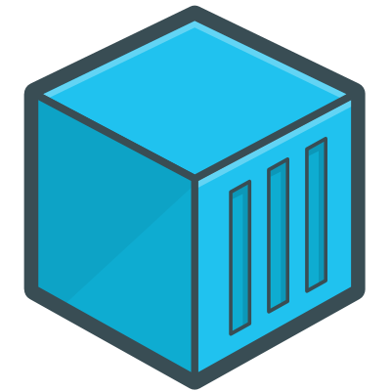
Image Sharing Between Containers
C1
C2
.NET Core App Image
…
.NET Core SDK
Base Image (Ubuntu)

Slide 18

Containers and Layers
C1
C2
Thin R/W Layer
Thin R/W Layer
.NET Core App Image
…
.NET Core SDK
Base Image (Ubuntu)

Slide 19
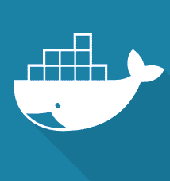
Docker Registry
A Service to host Docker images
Multiple options are available:
  Docker Hub - (Free for public images and Paid for private images)
  Docker Trusted Registry - (on-prem or on-cloud)
docker push
docker pull
Docker Registry

Slide 20
Docker Hub
A cloud-based repository for public and private images
Here, Docker users and partners create, test, store and distribute container images
Users can host and share their own custom images
For example, Nodejs image: https://hub.docker.com/_/node

Slide 21
Docker Container Life Cycle
Docker Registry
Pull
Push
Stop
Start
Restart
Build
Run
Commit
Dockerfile
Docker Local Instance
Notes:
Now, let's look at how a virtual machine (VM) is different from a container.
While containers may sound like a VM, the two are distinct technologies. With VMs each virtual machine includes the application, the necessary binaries and libraries and the entire guest operating system.
Whereas, Containers include the application, all of its dependencies, but share the kernel with other containers and are not tied to any specific infrastructure, other than having the Docker engine installed on its host – allowing containers to run on almost any computer, infrastructure and cloud.
Note - at this time, Windows and Linux containers require that they run on their respective kernel base, therefore, Windows containers cannot run on Linux hosts and vice versa.

Slide 22
Docker Container Lifecycle Contd..
Conception - BUILD an Image from a Dockerfile
Birth - RUN (create + start) a container
Reproduction
  COMMIT (persist) a container to a new image
  RUN a new container from an image
Sleep - KILL a running container
Wake - START a stopped container
Death - RM (delete) a stopped container
Extinction - RMI (delete image) a container image

Slide 23
Dockerfile Instructions
FROM : specifies the base (parent) image.
WORKDIR : sets the working directory for the instructions that follow.
RUN : runs a command and creates an image layer. Used to install packages into containers.
COPY : copies files and directories to the container.
CMD : provides command & arguments for a container. Support parameters override.
ENTRYPOINT : provides command & arguments for a container. Arguments persist.
EXPOSE : exposes a port.
VOLUME : creates a directory at host to access and store persistent data.
LABEL : provides metadata. Good place to include maintainer info.
ENV : sets a persistent environment variable.
ARG : defines a variable to pass to Docker at build-time.
Notes:
https://developer.okta.com/blog/2017/08/28/developers-guide-to-docker-part-2

Slide 24
Docker Multi-Stage Builds
Contains multiple FROM statement in Docker file.
Multistage Docker file is for creating intermediate images and from them create the final image to keep image small.
Use As for labeling or naming your build stage.
Only the instructions RUN, COPY, ADD create layers. Other instructions create temporary intermediate images, and do not increase the size of the build.

Slide 25
Docker Multi-Stage Builds
# Stage0: Download Base Image to host code
FROM mcr.microsoft.com/dotnet/aspnet:9.0 AS base
WORKDIR /app
EXPOSE 8080
# Stage1: Create build environment
FROM mcr.microsoft.com/dotnet/sdk:9.0 AS build
WORKDIR /src
# Copy csproj and restore as distinct layers
COPY *.csproj .
RUN dotnet restore
# Copy everything else and build
COPY . .
RUN dotnet publish -c Release -o out
# Stage2: Build final runtime image
FROM base AS final
WORKDIR /app
COPY --from=build /src/out .
ENTRYPOINT ["dotnet", "ASPNETApp.dll"]
//create image
docker build -t aspnet:v1 .
//or
docker build -t aspnet:v1 –f ./Dockerfile .
//run container
docker run –p 8081:8080 --name aspnetapp aspnet:v1
//or
docker run –d –p 8081:8080 --rm --name aspnetapp aspnet:v1
docker run -d -e "DefaultConnection=data source=172.17.0.2,1433; initial catalog=IBMDB;persist security info=True;user id=sa;password=YourStrong@Passw0rd;TrustServerCertificate=True" -p 8082:8080 --name webapi-container1 webapi:v1

Slide 26
Docker Build Best Practices
Use the smallest base image (alpine images) possible
Reduce the amount of clutter in your image
Use multi-stage builds
Try to create images with common layers
Tagging using semantic versioning
Try to avoid installing unnecessary packages and dependencies
Use a .dockerignore file to remove unnecessary content from the build context

Slide 27
Docker Engine
A runtime to build and run container based applications which can run anywhere consistently on any infrastructure.
Runs on various Linux (CentOS, Debian, Fedora, Oracle Linux, RHEL, SUSE, and Ubuntu) and Windows Server OS.
Provides built in orchestration, container networking, out of the box security, volume and plugins.
Notes:
Uses Linux Kernel namespaces and control groups
Namespaces provide for isolated workspace

Slide 28
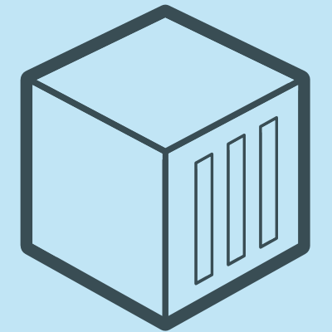
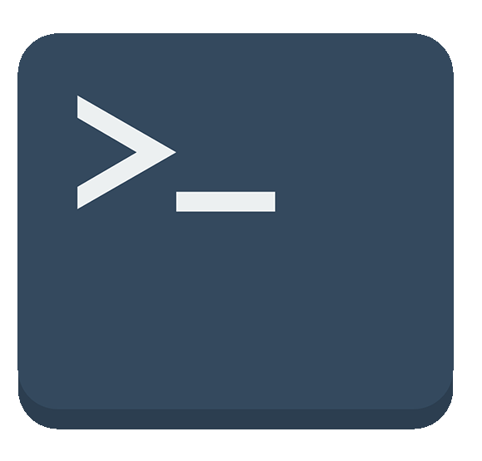
Docker Engine Architecture
Docker Engine
R
E
S
T
A
P
I
Server Daemon
Containers
Images
Volumes
Docker CLI
Networks
Plugins
Notes:
https://www.studytrails.com/devops/docker-architecture-engine-containerd-runc/

Slide 29
Docker Engine Contd..
Docker engine or Docker is a client server application that builds and executes containers using Docker components.
REST API is a primary mode of communication between Docker Client and Docker Daemon.
Docker Daemon is a server which interacts with the operating system and performs all kind of services.
The Docker Daemon listens for REST API request and performs the operation.
Notes:
Docker engine runs on port 2376 by default.

Slide 30
Docker Storage
The main difference between a container and an image is the top writable layer where the container data is stored.
When the container is deleted, the writable layer is also deleted. But the underlying image remains unchanged.
Use Docker volume to share the same data by multiple containers.

Slide 31
Container R/W Layer
C1
Thin R/W Layer
SQL Database
>docker pull mcr.microsoft.com/mssql/server:2022-CU12-ubuntu-22.04
>docker run -e "ACCEPT_EULA=Y" -e "SA_PASSWORD=YourStrong@Passw0rd" -p 5020:1433 --name sqlserver -d mcr.microsoft.com/mssql/server:2022-CU12-ubuntu-22.04
…
SQL Server
Server: localhost,5020
User: sa
Pwd: YourStrong@Passw0rd
Base Image (Ubuntu)
Notes:
Server: localhost,5020
Pwd: YourStrong@Passw0rd

Slide 32
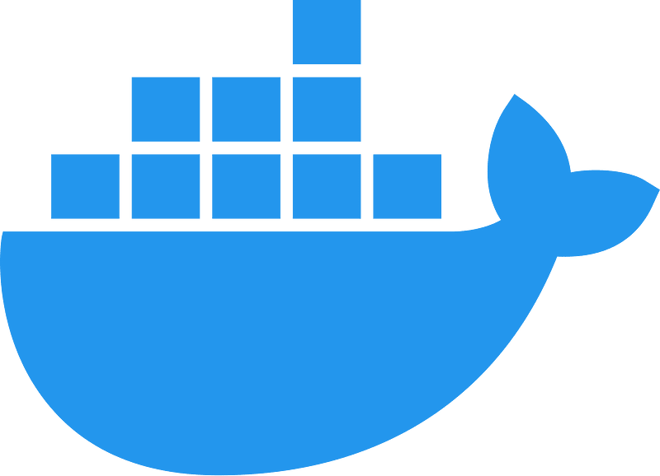
Docker Storage Options
bind mount
volume
tempfs mount
File System
Memory
Docker Area
Notes:
https://stackoverflow.com/questions/34357252/docker-data-volume-vs-mounted-host-directory

Slide 33
Docker Storage Options Contd..
Bind mounts may be stored anywhere on the host system. They may even be important system files or directories. Non-Docker processes on the Docker host can modify them at any time.
Volumes are stored in a part of the host filesystem which is managed by Docker (/var/lib/docker/volumes/ on Linux). Non-Docker processes should not modify this part of the filesystem. Volumes are the best way to persist data in Docker.
tmpfs mounts are stored in the host system’s memory only, and are never written to the host system’s filesystem.

Slide 34
Docker Volumes
Volumes are used to store data used by a container.
Volumes can be shared among multiple containers.
A volume does not increase the size of the containers since it exists outside the container lifecycle.
Volumes can be used to share files between a host system and the Docker container
A volume exists even after the container is deleted.
Volumes work on both Linux and Windows containers

Slide 35
Docker Volumes Use Case
Docker volumes are helpful when you run database as a container for storing your data.
Docker Container
Volume
Server: localhost,5020
User: sa
Pwd: YourStrong@Passw0rd
Docker Host
docker run -e "ACCEPT_EULA=Y" -e "SA_PASSWORD=YourStrong@Passw0rd" -p 5020:1433 --name sqlserver -v c:/docker/databases:/var/opt/mssql/data -d mcr.microsoft.com/mssql/server:2022-CU12-ubuntu-22.04
Notes:
You can't mount /var/opt/mssql
Instead, you need to mount /var/opt/mssql/data
You can start such a container and enter the data. Where is it stored? What happens when you stop the container or remove it? You can start the new one, but the database will be empty again. Unless it's your testing environment, you don't expect such a scenario.
Docker volume is the Docker host's directory mounted inside the container. It allows the container to write to the host's filesystem as it was writing to its own. The mechanism is presented in the following diagram:

